Slide 1
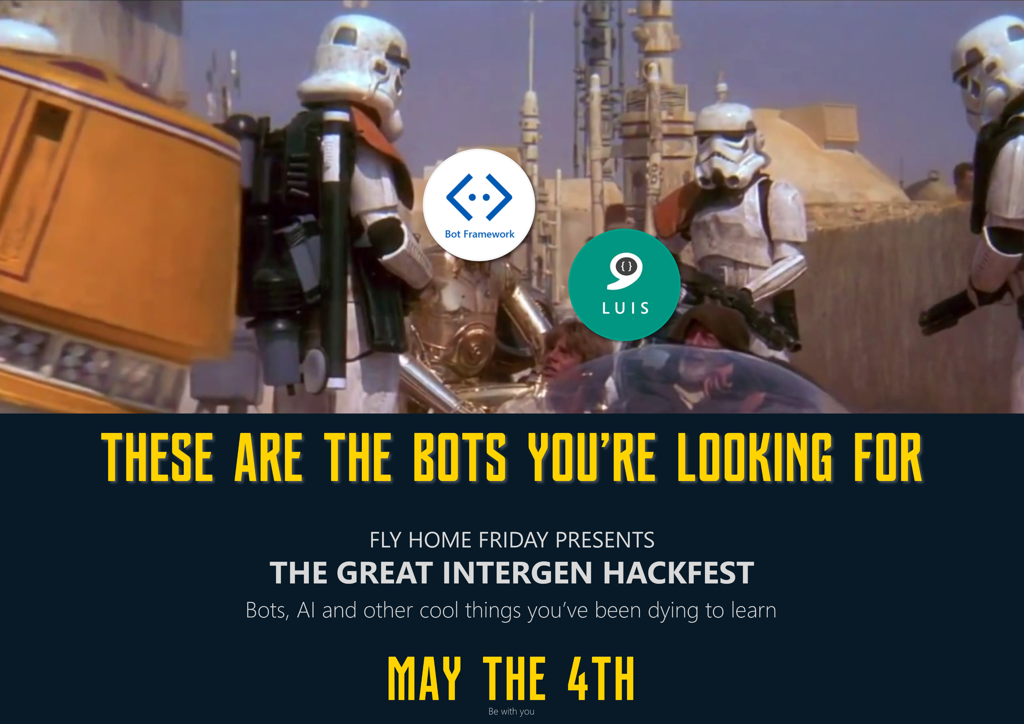

Slide 2
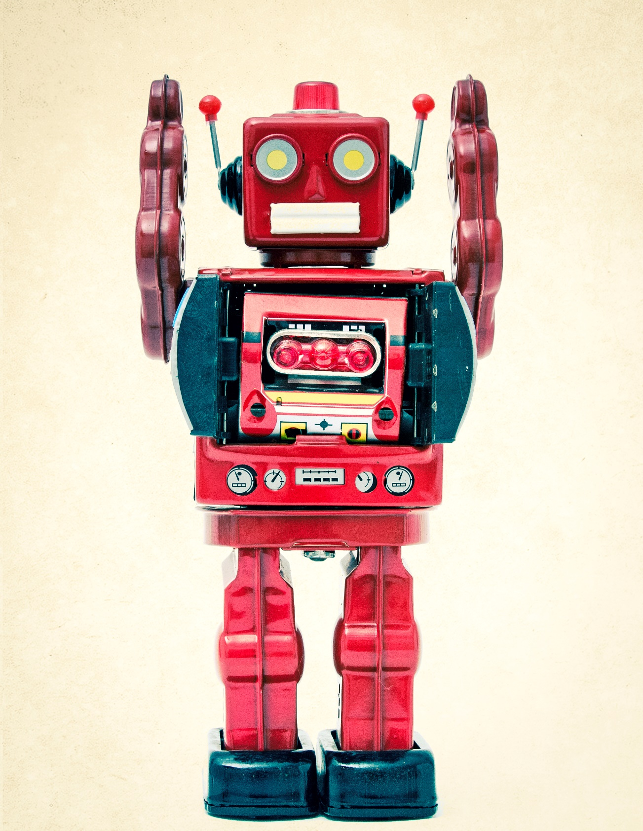

TECH STREAM

Slide 3
Agenda
Purpose
Demo
Get started
Some theory
Split into groups
Build!

Slide 4
Using some customers from across our offices gives your bot a target and purpose. Think loose guiding principals…
You can choose from any of those customers. What you do for them is up to you!

Slide 5
Customers…
Sky City
Whitakers
Christchurch Airport
Intergen
Real Journeys

Slide 6
What’s a ChatBot?

Slide 7
Software which conducts a conversation through auditory or textual methods

Slide 8
Microsoft Bot Framework
A framework that allows you to build and deploy intelligent chatbots
Bot Builder SDK (.NET, Node.js)
Bot Connector: Connects your bots with different communication channels (Skype, Messenger)
To enhance the experience with more human-like interaction, incorporate components from Cognitive Services
Vision, speech, language understanding, knowledge, search, location

Slide 9
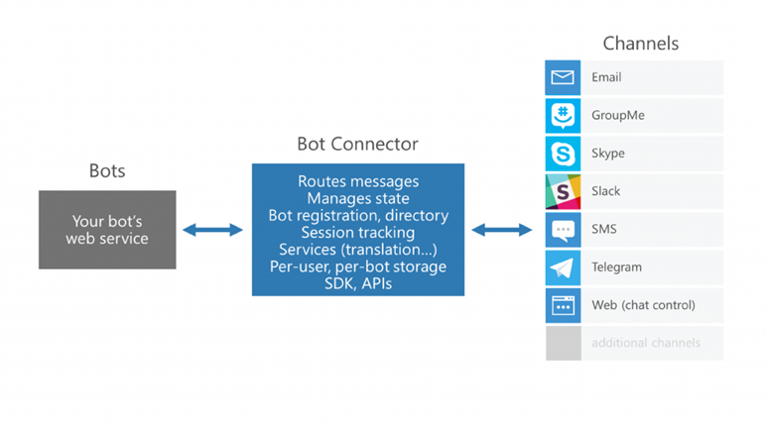
Bot Communication
High level architecture

Slide 10
Demo
bit.ly/bot-hackfest-demo
Notes:
Navigate to the demo site and briefly demonstrate

Slide 11
Get started
bit.ly/bot-hackfest
Notes:
Run through getting started - download and run the bot locally through the emulator and demonstrate the same deployed version running in an emulator
Run through the comments 1-14 in the DemoDialog.cs and NameDialog.cs to brifly show the flow.

Slide 12
Some theory
bit.ly/bot-hackfest

Slide 13
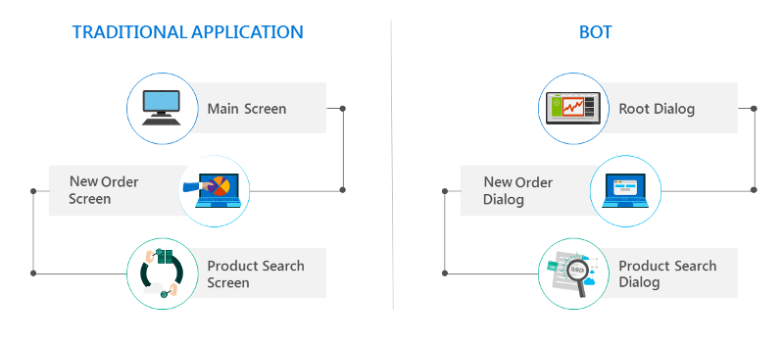
Conversation flow / dialogs
Dialogs enable the bot developer to logically separate areas of bot functionality and guide conversation flow.

Slide 14
Dialog lifecycle
When a dialog is invoked, it takes control of the conversation flow. Every new message will be subject to processing by that dialog until it either closes or redirects to another dialog.
Every dialog method must end with one of the following:
context.Wait() Wait for a user message
context.Fail() Exit a dialog with failure, return to parent
context.Done() Exit a dialog, send response to parent
context.Forward() Forward the received message to another dialog
context.Call() Call another dialog

Slide 15
State / data storage
Bot Framework has three data stores. These are stored in an in-memory store, or if an Azure Storage connection string is provided, in Azure Table Storage.
The three stores are:
User data associated with a specific user
Conversation data associated with a specific conversation with a specific user
PrivateConverstion data associated with a specific user within a specific conversation
Use DataStoreKey and BotDataService to read and write from data storage.

Slide 16
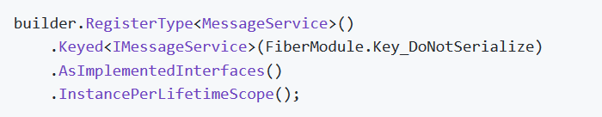
Autofac / IoC
Bot Framework will serialize the dialog stack and all instances and save to the bot store against between each message of a conversation.
To ensure services do not get serialized and are instantiated through Autofac every time, use the FiberModule.Key_DoNotSerialize key.
Use the IoC examples in code for registering additional types.

Slide 17
Dialog Builder
The DialogBuilder simplifies resolution of a dialog through an Autofac registration. All logic pertaining to dialog creation/resolution should be contained within the DialogBuilder class.
Use the examples and implementations in the following files:
IoC registration IoC/ApplicationDialogsModule.cs
IoC resolution Dialogs/DialogBuilder.cs
Usage Dialogs/DemoDialog.cs
A conversation, its dialog stack, and its state gets serialized into the bot data store.
For this reason, ALL dialogs must have the [Serializable] attribute applied to the class.

Slide 18
Submit
Submit your bot idea by Monday 11:59am (noon) to bit.ly/bot-hackfest-submit
This can be a video recording or a link to the published bot. We need to see it running. You won’t be judged on how many bugs there are, but on your idea(s) and execution.
There is no ‘list’ of deliverables - share with us everything that screams “we should win!”.
Impress us!

Slide 19
Any questions?

Slide 20
Next steps
Brainstorm
Design a conversation using Bot Society (wireframing equivalent for Bots)
Investigate the available Cognitive Services to make your bots smarter
Browse the samples on Github and https://dev.botframework.com/
Customers
Sky City
Whitakers
Christchurch Airport
Intergen
Real Journeys
Links
Docs bit.ly/bot-hackfest
Demo bit.ly/bot-hackfest-demo
Base project bit.ly/bot-hackfest-base
Yammer group bit.ly/bot-hackfest-yammer
Submit bit.ly/bot-hackfest-submit

